Slide 1
Chapter 18
Introduction to Network Layer

Slide 2
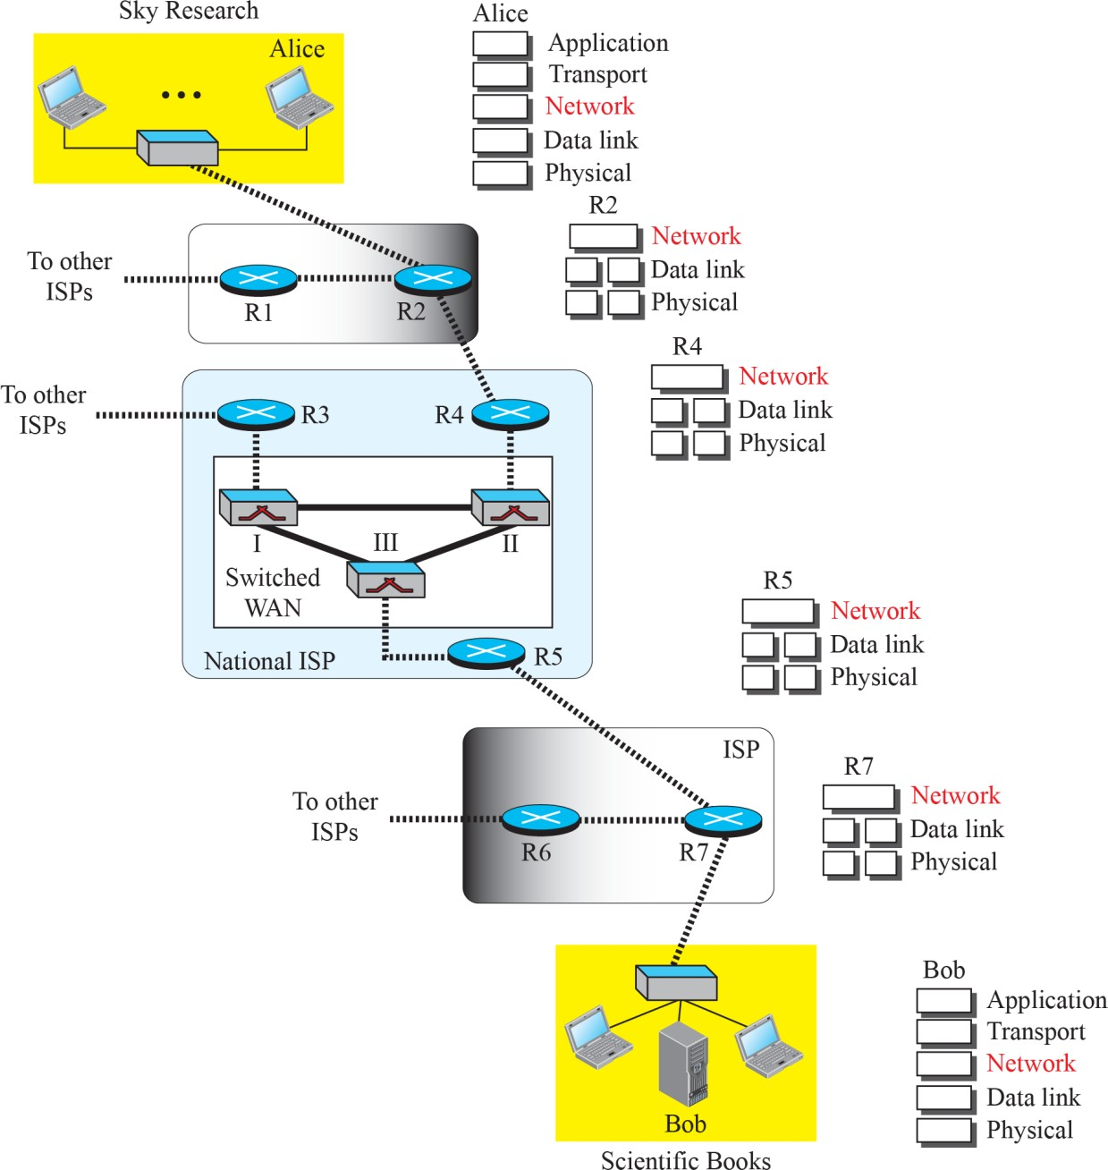
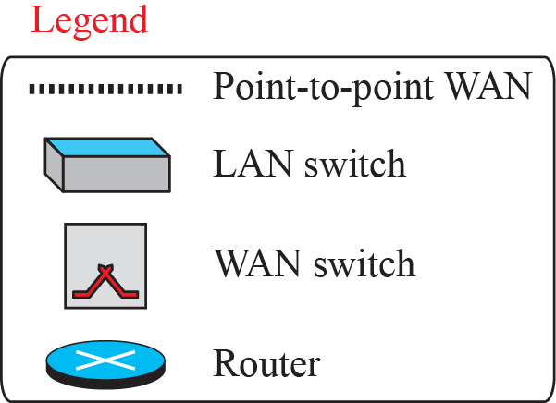
Communication at the network layer

Slide 3
Packetizing
encapsulating the payload in a network-layer packet at the source and decapsulating the payload from the network-layer packet at the destination.
In other words, one duty of the network layer is to carry a payload from the source to the destination without changing it or using it.
Similar to the service of a carrier such as the postal office

Slide 4


Routing and Forwarding
Other duties of the network layer are
routing
forwarding

Slide 5
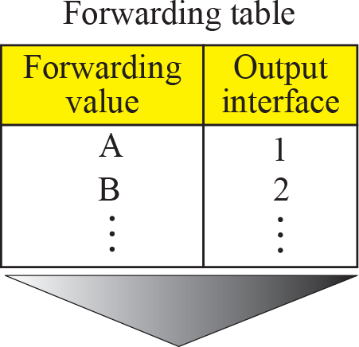


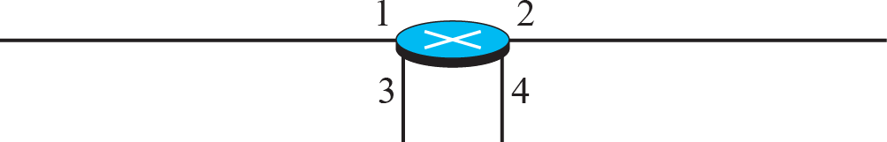
Forwarding process
Forwarding
Send the packet out of interface 2
value
B Data
B
Data

Slide 6


PACKET SWITCHING
A router is a switch that creates a connection between an input port and an output port (or a set of output ports

Slide 7


Datagram Approach
The network layer was designed to provide a connectionless service in which the network-layer protocol treats each packet independently, with each packet having no relationship to any other packet.
The idea was that the network layer is only responsible for delivery of packets from the source to the destination.
In this approach, the packets in a message may or may not travel the same path to their destination.

Slide 8
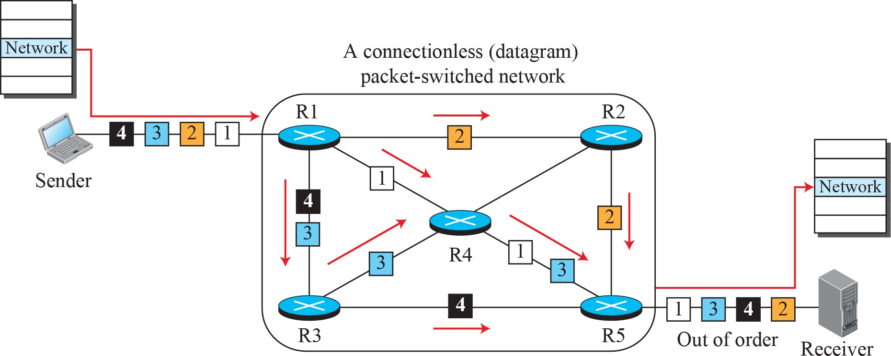
A connectionless packet-switched network

Slide 9



Virtual-Circuit Approach
There is a relationship between all packets belonging to a message.
Before all datagrams in a message can be sent, a virtual connection should be set up to define the path for the datagrams.
After connection setup, the datagrams can all follow the same path.
In this type of service, not only must the packet contain the source and destination addresses, it must also contain a flow label, a virtual circuit identifier that defines the virtual path the packet should follow.

Slide 10
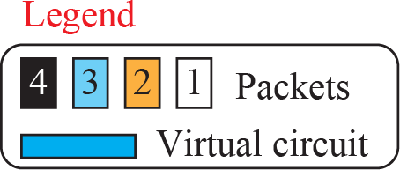
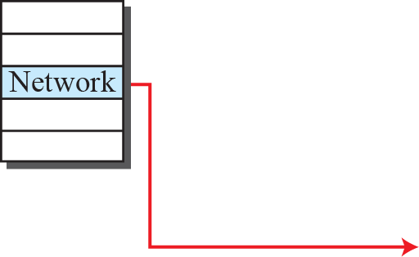
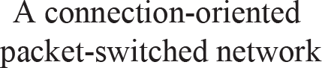

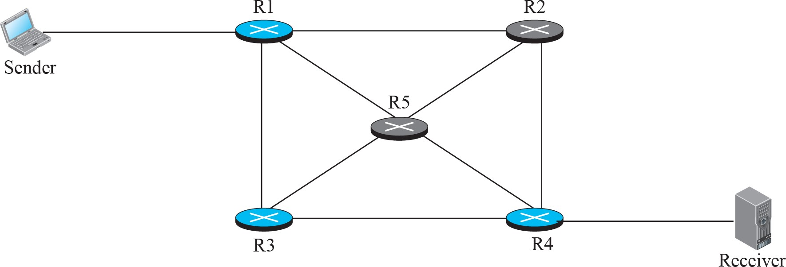


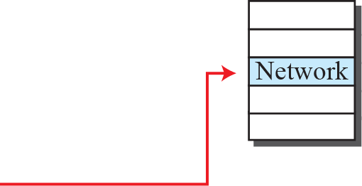
A virtual-circuit packet-switched network

Slide 11
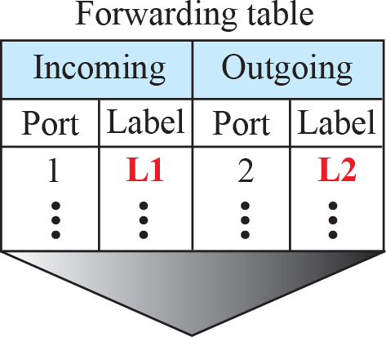


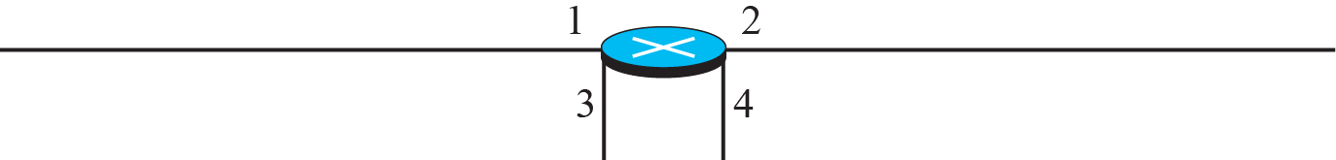


Forwarding process in a router when used in a virtual
circuit network

Slide 12
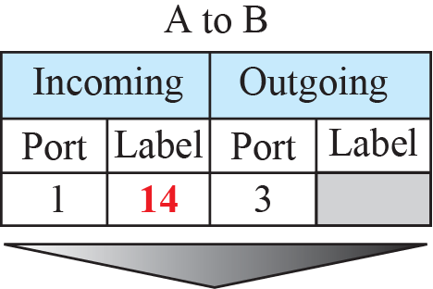
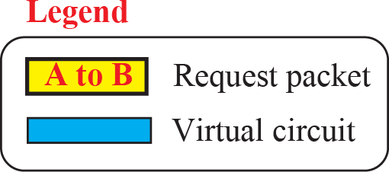
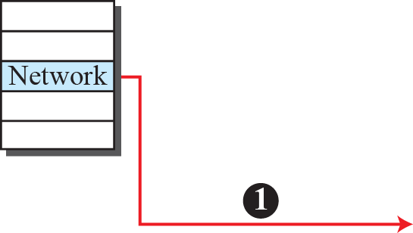
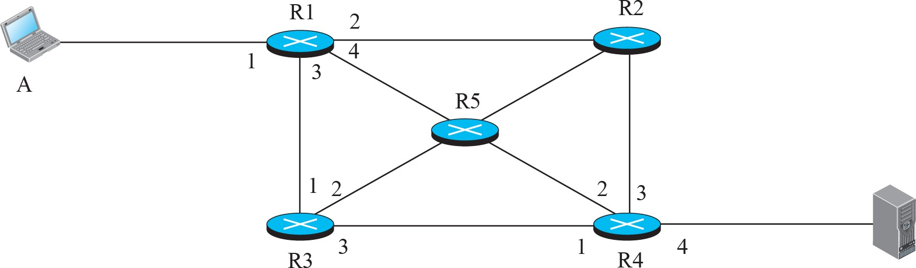
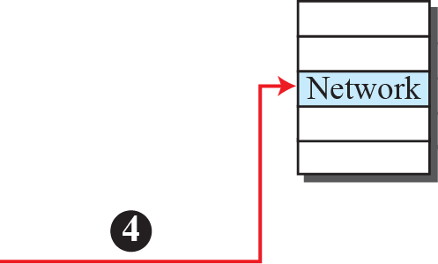


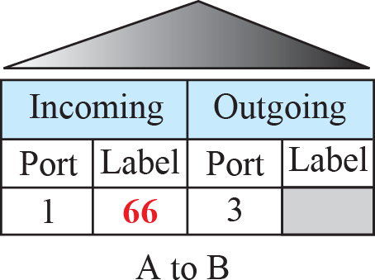
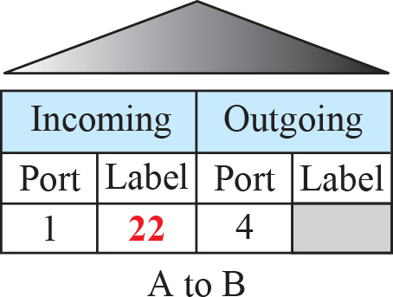
A to B
Sending request packet in a virtual-circuit network
A
t
o B
A to B
A to B

Slide 13
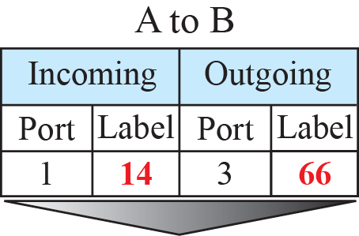
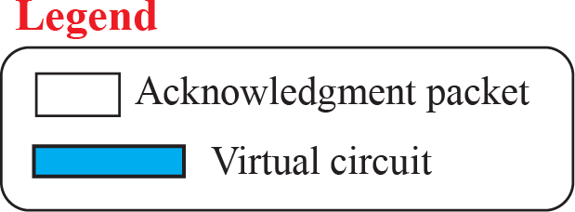
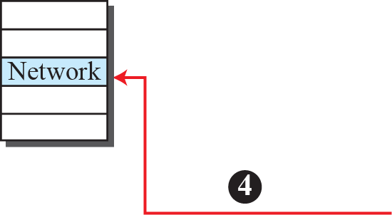
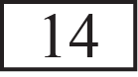
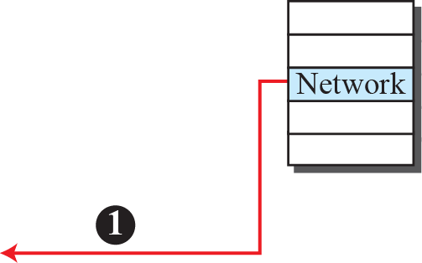





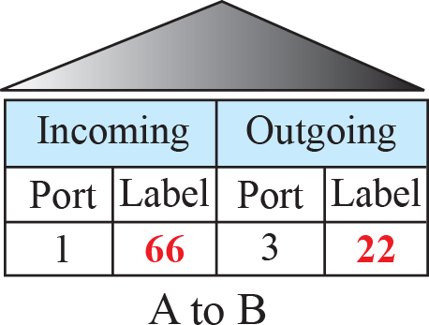
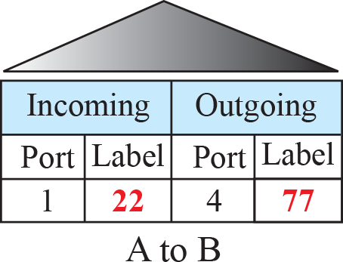
Sending acknowledgments in a virtual-circuit network

Slide 14
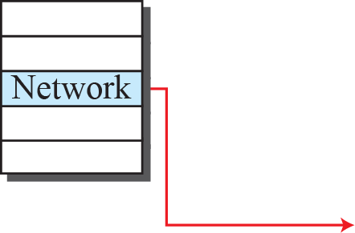
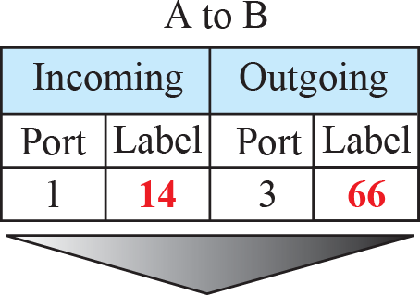
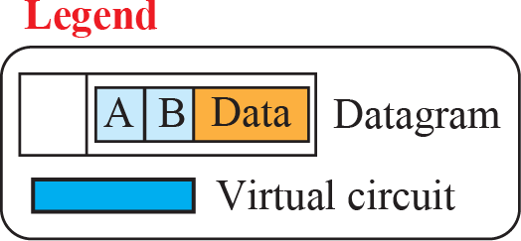

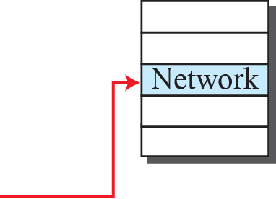



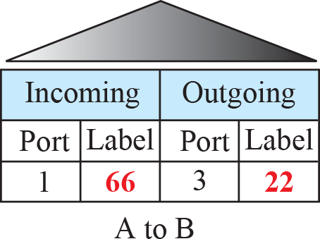
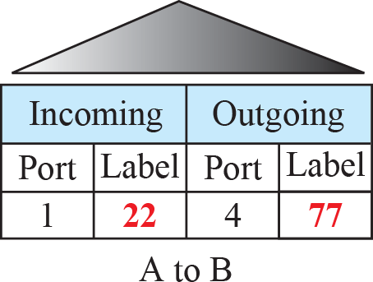
Flow of one packet in an established virtual circuit

Slide 15




NETWORK-LAYER PERFORMANCE
The performance of a network can be measured in terms of delay, throughput, and packet loss. Congestion control is an issue that can improve the performance.

Slide 16

Delay
The delays in a network can be divided into four types:
transmission delay
propagation delay
processing delay
queuing delay

Slide 17

Throughput
is defined as the number of bits passing through the point in a second, which is actually the transmission rate of data at that point.
In a path from source to destination, a packet may pass through several links (networks), each with a different transmission rate.
How can we determine the throughput of the whole path?

Slide 18
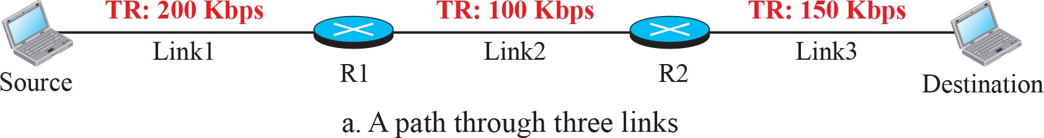

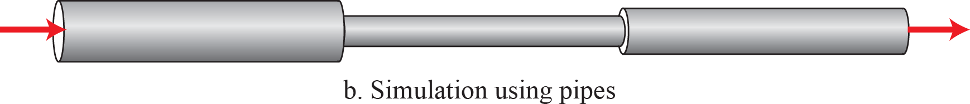
Throughput in a path with three links in a series

Slide 19
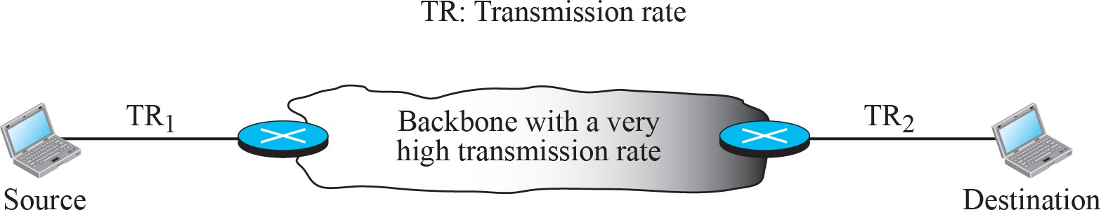
A path through the Internet backbone

Slide 20
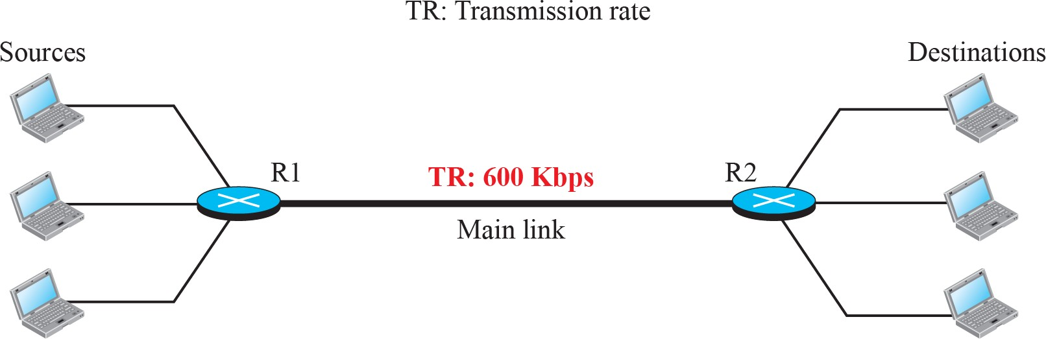
Effect of throughput in shared links

Slide 21


Packet Loss
Another issue that severely affects the performance of communication is the number of packets lost during transmission.
The effect of packet loss on the Internet network layer is that the packet needs to be resent, which in turn may create overflow and cause more packet loss.

Slide 22
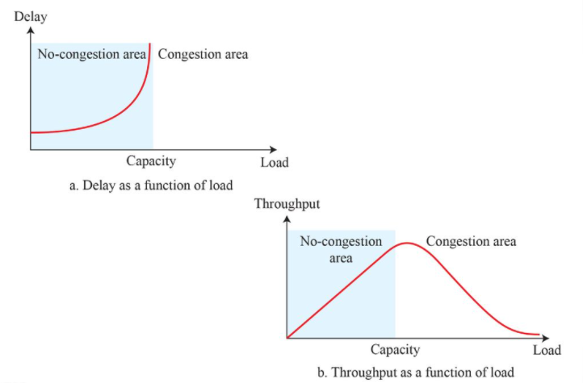
Congestion control
A state occurs in the network layer when the message traffic is so heavy that it slows down network response time.

Slide 23
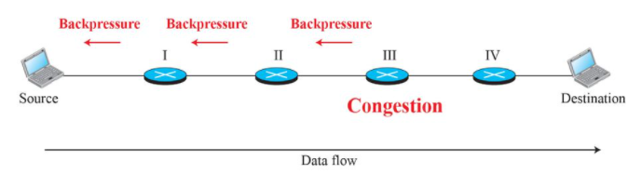
Congestion control
Open Loop (Prevention)
Closed Loop (removal)
Retransmission Policy
Window Policy
Acknowledgement Policy
Discarding Policy
Admission Policy
Back Pressure
Choke Packet
Implicit signaling
Explicit signaling

Slide 24
IPv4 ADDRESSES
The identifier used in the IP layer of the TCP/IP protocol suite to identify the connection of each device to the Internet.
An IPv4 address is a 32-bit address that uniquely and universally defines the connection of a host or a router to the Internet.
The IP address is the address of the connection, not the host or the router.

Slide 25

Three different notations in IPv4 addressing

Slide 26
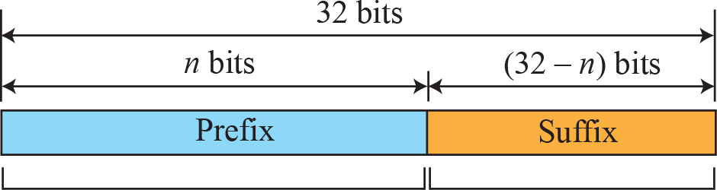
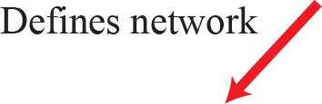
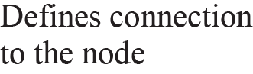
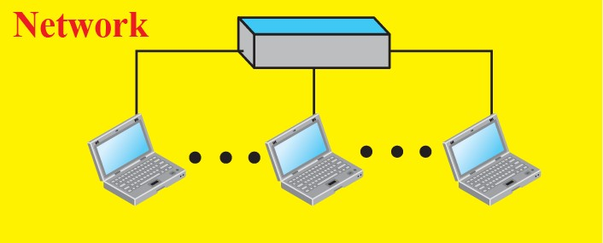

Hierarchy in addressing

Slide 27
Classful Addressing
The whole address space was divided into five classes (class A, B, C, D, and E)
This scheme is referred to as classful addressing.

Slide 28
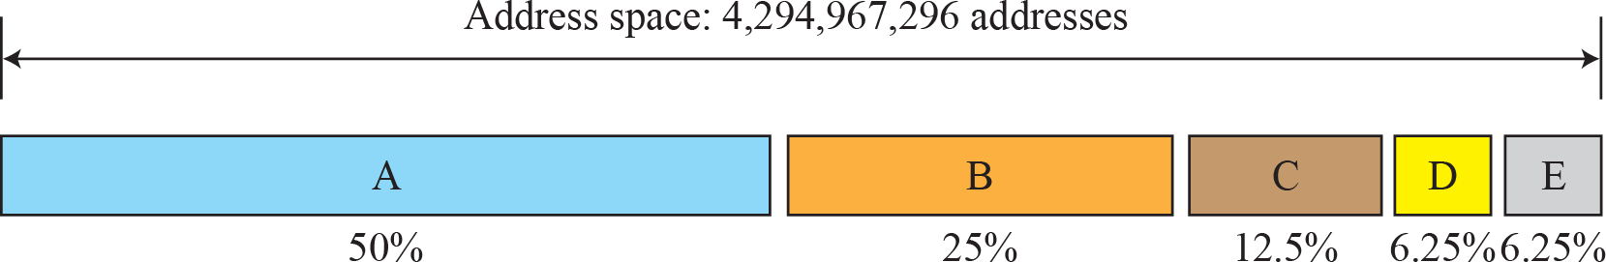
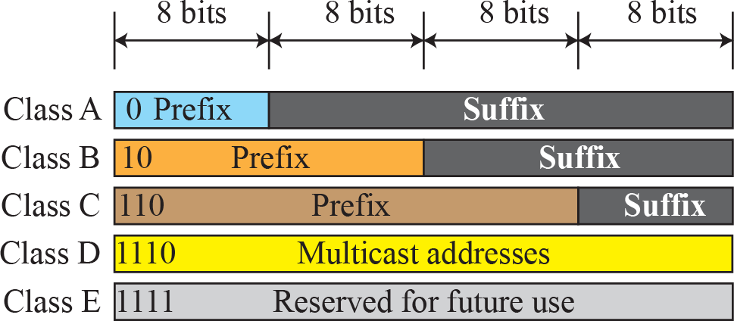
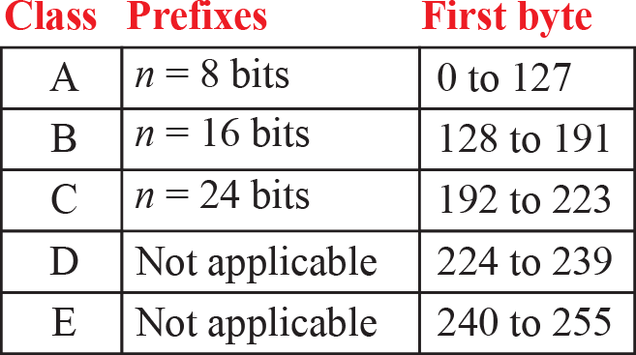
Occupation of the address space in classful addressing

Slide 29
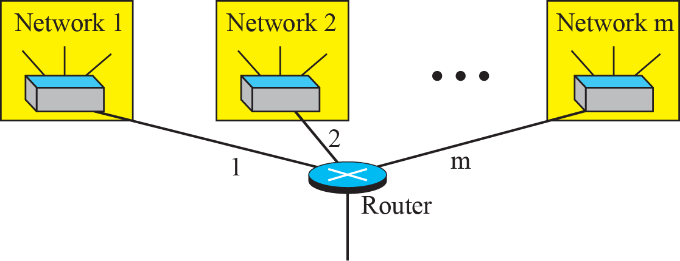
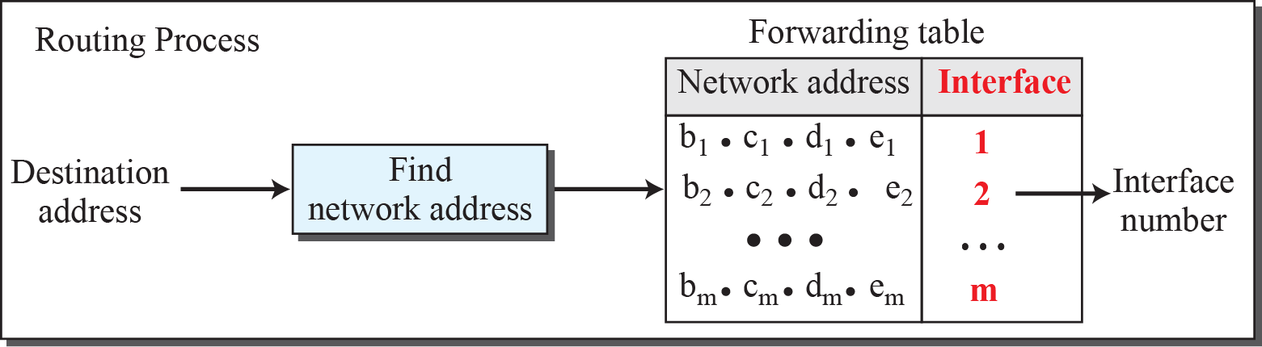
Network address

Slide 30
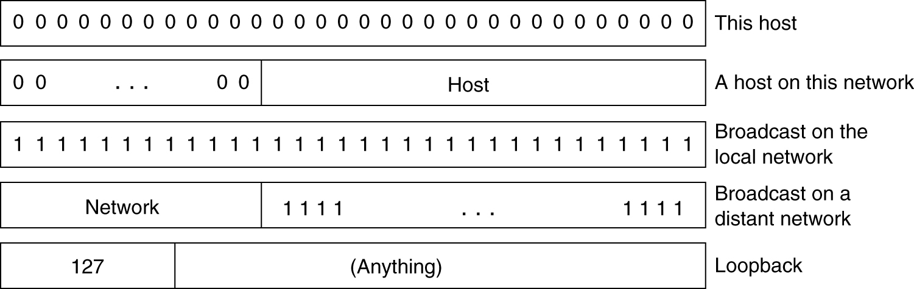
Special IP addresses.
Private IP network is an IP network that is not directly connected to the Internet
Private networks use addresses from the following experimental address ranges (non-routable addresses):
10.0.0.0 – 10.255.255.255 (16,777,216 hosts)
172.16.0.0 – 172.31.255.255 (1,048,576 hosts)
192.168.0.0 – 192.168.255.255 (65,536 hosts)

Slide 31
Subnetting
Problem: Organizations have multiple groups/entities within their organization which are independently managed. Each would prefer to manage their own IT facilities, i.e., own network
Solution 1: Allocate to each entity their own IP network/domain
Organization must own multiple IP address domains
Expensive (each IP domain costs money) and cumbersome to manage
University Network
Engineering
School
Medical
School
Library
Solution 2: Add another level of hierarchy to the existing IP addressing structure
Subnetting

Slide 32
Basic Idea of Subnetting
Split the host number portion of an IP address into a subnet number and a (smaller) host number.
Result is a 3-layer hierarchy
Then:
Subnets can be freely assigned within the organization
Internally, subnets are treated as separate networks
Subnet structure is not visible outside the organization
network prefix
host number
network prefix
subnet number
host number
extended network prefix

Slide 33
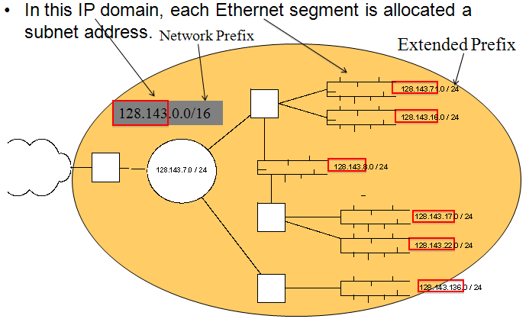
Typical Addressing Plan for an Organization that uses subnetting

Slide 34
CIDR - Classless Interdomain Routing
Goals:
Restructure IP address assignments to increase efficiency
Hierarchical routing aggregation to minimize route table entries
Key Concept: The length of the network id (prefix) in IP addresses is arbitrary/flexible and is defined by the network hierarchy.
Consequence:
Routers use the IP address and the length of the prefix for forwarding.
All advertised IP addresses must include a prefix

Slide 35
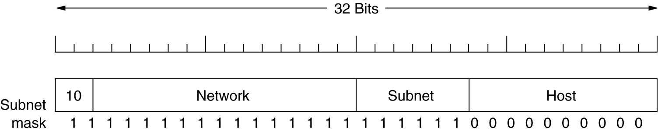
Subnet mask
A class B network subnetted into 64 subnets.
Subnet Mask indicate the split between network + subnet number and host

Slide 36
Advantages of Subnetting
With subnetting, IP addresses use a N-layer hierarchy. E.g., a 3 layer hierarchy would be:
Network (IP domain)
Subnet
Host
Improves efficiency of IP addresses by not consuming an entire address space for each physical network.
Reduces router complexity. Since external routers do not know about subnetting, the complexity of routing tables at external routers is reduced.
Note: Length of the subnet mask need not be identical at all subnetworks.

Slide 37

Subnetting Example:

Slide 38

Network without subnets

Slide 39

Same Network with Subnets

Slide 40

Same network with different subnetmasks

Slide 41
Finding the Subnet Address
Given an IP address, we can find the subnet address the same way we found the network address. We apply the mask to the address. We can do this in two ways: straight or short-cut.
Straight Method
In the straight method, we use binary notation for both the address and the mask and then apply the AND operation to find the subnet address.

Slide 42
What is the subnetwork address if the destination address is 200.45.34.56 and the subnet mask is 255.255.240.0?
Solution
11001000 00101101 00100010 00111000
11111111 11111111 11110000 00000000
11001000 00101101 00100000 00000000
The subnetwork address is 200.45.32.0.

Slide 43
CIDR: Prefix Size vs. Host Space
CIDR Block Prefix # of Host Addresses
/27 32 hosts
/26 64 hosts
/25 128 hosts
/24 256 hosts
/23 512 hosts
/22 1,024 hosts
/21 2,048 hosts
/20 4,096 hosts
/19 8,192 hosts
/18 16,384 hosts
/17 32,768 hosts
/16 65,536 hosts
/15 131,072 hosts
/14 262,144 hosts
/13 524,288 hosts

Slide 44


Example
An organization is granted a block of addresses with the beginning address 14.24.74.0/24. The organization needs to have 3 subblocks of addresses to use in its three subnets: one subblock of 10 addresses, one subblock of 60 addresses, and one subblock of 120 addresses. Design the subblocks.

Slide 45



ADDRESS AGGREGATION
In Supernetting, multiple networks are combined into a bigger network termed as a Supernetwork or Supernet

Slide 46
Example 19.10
An ISP is granted a block of addresses starting with 190.100.0.0/16 (65,536 addresses). The ISP needs to distribute these addresses to three groups of customers as follows:
a. The first group has 64 customers; each needs 256 addresses.
b. The second group has 128 customers; each needs 128 addresses.
c. The third group has 128 customers; each needs 64 addresses.
Design the subblocks and find out how many addresses are still available after these allocations.

Slide 47
Example 19.10 (continued)
Solution
Figure 19.9 shows the situation.
Group 1
For this group, each customer needs 256 addresses. This means that 8 (log2 256) bits are needed to define each host. The prefix length is then 32 − 8 = 24. The addresses are

Slide 48
Example 19.10 (continued)
Group 2
For this group, each customer needs 128 addresses. This means that 7 (log2 128) bits are needed to define each host. The prefix length is then 32 − 7 = 25. The addresses are

Slide 49
Example 19.10 (continued)
Group 3
For this group, each customer needs 64 addresses. This means that 6 (log₂64) bits are needed to each host. The prefix length is then 32 − 6 = 26. The addresses are
Number of granted addresses to the ISP: 65,536
Number of allocated addresses by the ISP: 40,960
Number of available addresses: 24,576

Slide 50

Figure 19.9 An example of address allocation and distribution by an ISP

Slide 51


DHCP
address assignment in an organization can be done automatically using the Dynamic Host Configuration Protocol (DHCP).
DHCP is an application-layer program, using the client-server paradigm, that actually helps TCP/IP at the network layer.

Slide 52





Operation of DHCP

Slide 53

NAT
A technology that can provide the mapping between the private and universal addresses, and at the same time support virtual private networks
allows a site to use a set of private addresses for internal communication and a set of global Internet addresses (atleast one) for communication with the rest of the world

Slide 54





Address translation

Slide 55


Translation

Slide 56

Position of IPv4 in TCP/IP protocol suite

Slide 57

The IPv4 (Internet Protocol) header.
Identification
Allow destination host to determine which datagram a newly arrived fragment belongs to. All fragments of a datagram has same id value

Slide 58

The IP Protocol
Some of the IP options.

Slide 59
IPv6 - IP Version 6
IP Version 6
Is the successor to the currently used IPv4
Specification completed in 1994
Makes improvements to IPv4 (no revolutionary changes)
One (not the only !) feature of IPv6 is a significant increase in size of the IP address to 128 bits (16 bytes)
IPv6 vs. IPv4: Address Comparison
IPv4 has a maximum of
2³² ≈ 4 billion addresses
IPv6 has a maximum of
2¹²⁸ = (2³²)⁴ ≈ 4 billion x 4 billion x 4 billion x 4 billion addresses

Slide 60

IPv6 Header

Slide 61
Notation of IPv6 addresses
Convention: The 128-bit IPv6 address is written as eight 16-bit integers (using hexadecimal digits for each integer)
CEDF:BP76:3245:4464:FACE:2E50:3025:DF12
Short notation:
Abbreviations of leading zeroes:
CEDF:BP76:0000:0000:009E:0000:3025:DF12 → CEDF:BP76:0:0:9E :0:3025:DF12
“:0000:0000” can be written as “::”
CEDF:BP76:0:0:FACE:0:3025:DF12 →
CEDF:BP76::FACE:0:3025:DF12
IPv6 addresses derived from IPv4 addresses have different formats. Convention allows to use IPv4 notation for the last 32 bits.
128.143.137.144 -> 0:0:0:0:0:ffff:808F:8990

Slide 62

Extension Headers
5-69
IPv6 extension headers.

Slide 63

Extension Headers (2)
The hop-by-hop extension header for large datagrams (jumbograms).

Slide 64

Extension Headers (3)
The extension header for routing.

Slide 65

Comparison between IPv4 and IPv6 packet headers

Slide 66
Protocols
ARP
RARP
BOOTP
ICMP

Slide 67
Address Resolution Protocol(ARP)
Communication protocol used to discover the data-link layer address(Layer 2 address like Media Access Control(MAC) address) associated with an Internet layer address(Layer 3 address like IPv4 address).
Reverse Address Resolution Protocol
Allows a newly booted work station to broadcast its ethernet address
RARP server looksup the Ethernet address in its configuration files and sends back the corresponding IP address
Since the destn address is all 1s it will not be forwarded by routers, so an RARP server is needed in every network
BOOTP
Uses UDP messages which are forwarded over routers.
Provides a diskless workstation with information such as IP address of file server holding memory image, IP address of default router, and subnet mask
Requires manual configuration

Slide 68

Internet Control Message Protocol
When something unexpected occurs, the event is reported by ICMP
The principal ICMP message types.
Pkt with DF bit 1, cannot pass through small pkt n/w

